Slide 1
Introduction to Neural networks with Data wrangling techniques

Slide 2
Content :
Regularisation
What are Neural networks?
Activation functions
Data preprocessing
Overfitting and Regularization
Application for neural networks
Conclusion

Slide 3
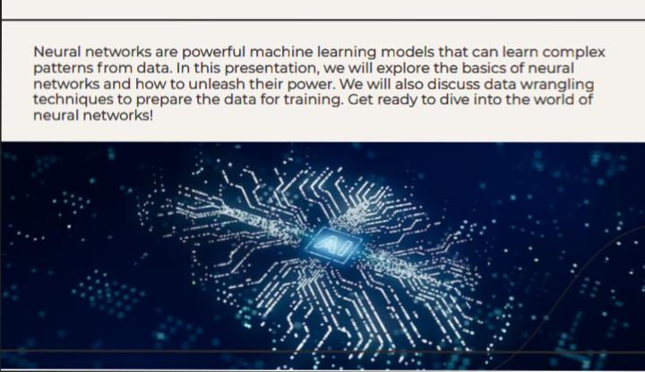

Slide 4
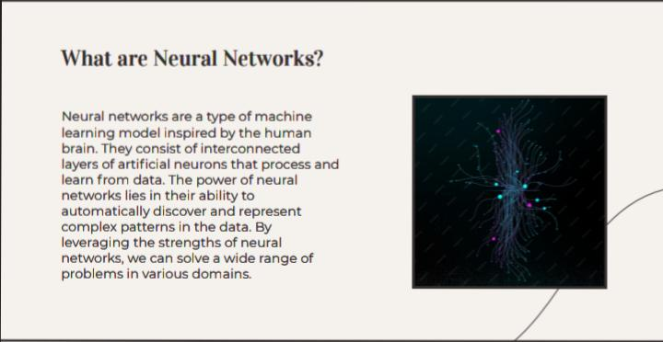

Slide 5
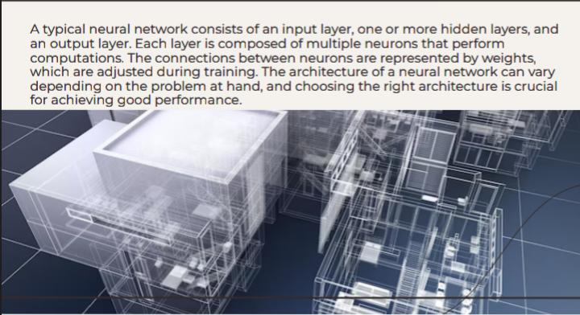

Slide 6
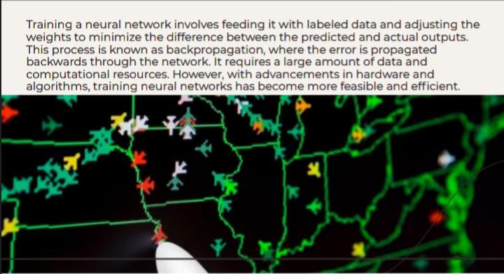

Slide 7
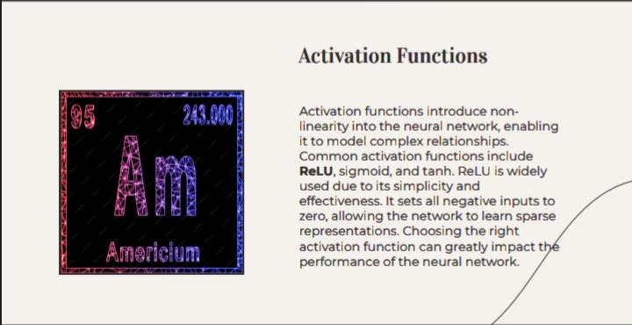

Slide 8
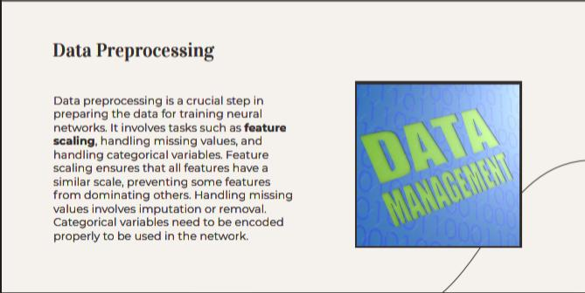

Slide 9
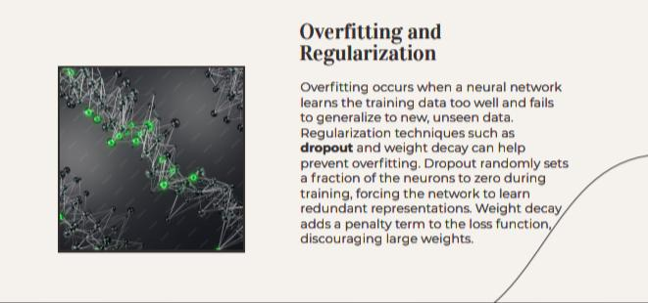

Slide 10
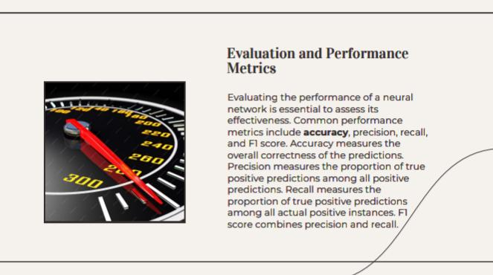

Slide 11
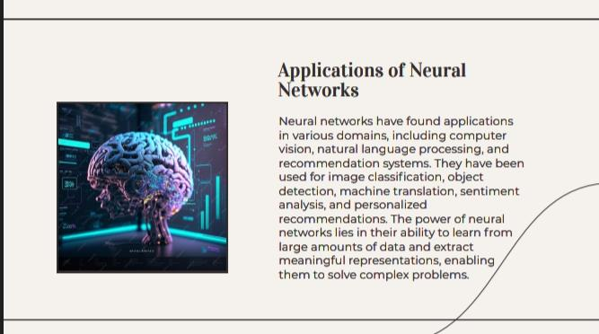

Slide 12
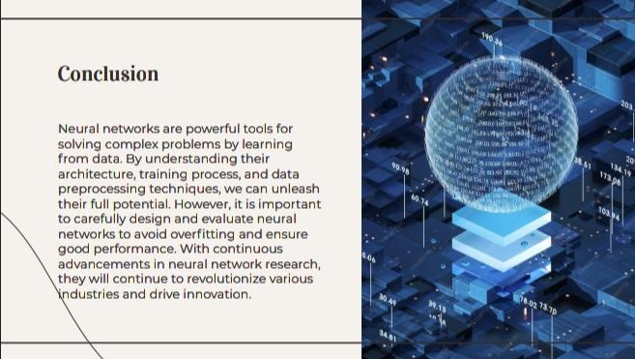

Slide 13


